Slide 1




Slide 2
PRoduct Lifecycle Management
met 3DEXPERIENCE

Slide 3
Vandaag
Typische noden bij onze klanten
Agenda
Het 3DEXPERIENCE Platform
Le service client 4.0
Customer Service challenges
Enkele van onze klanten
Onze PLM aanpak
Lessons learned
Waarom Visiativ

Slide 4
Noden Klant A
•Veel technische tekeningen zonder echte toegevoegde waarde
•Artikelbeheer zonder tekeningen is niet mogelijk
•Techneuten zijn niet bezig met de technische inhoud
•Projectplanning ingewikkeld
•Geen mogelijkheid van volgen van revisies
•Handmatig werk invoeren stuklijsten
•Afhankelijkheid van R&D is hoog voor fabriek
•Fabriek geen invloed op M-BOM
•Wijzigingen invoeren langzaam
•Nieuwe samenstellingen in voeren langzaam
•Geen inzicht lopende wijzigingen
•Geen inzicht in in-en uitfaseringsplannen(kosten, tijd, planning)
•Geen inzicht ingevoerde wijzigingen
•Geen overzicht productassortiment
•CAD (assemb) modellen komen niet overeen met de PDF’s

Slide 5
Klant A : Huidige situatie BOM Beheer
•BOM (Bill of Materials) uitleg:
•Stuklijst beheer
•Momenteel geen verschil tussen E-BOM en M-BOM
•E-BOM Engineering BOM
•M-BOM Manufacturing BOM
•S-BOM Service BOM
Er is behoefte om ook service artikelen en samenstellingen te beheren.
•PDM: Revisiebeheer op tekening via PDF’s
•PDM: Engineering en Quality validatie via workflow
•Specificatie
•Momenteel alle specificaties en BOM gecombineerd
•Onderdeel specificatie (tbv leverancier)
•Assemblage specificatie (tbv leverancier en/of fabriek)
•Stuklijsten invoeren
•Handmatig invoeren in ERP vanaf gevalideerde tekening

Slide 6
Klant B
  We wants to apply E-BOM and M-BOM and needs a good integration with the new ERP..
  About functionality a special attention needs to be given to long lead parts and obsolete parts.
  Below some functional requirements
    Product Change Management / BOM management / CAx Integration /Document & Content Management
    ERP Integration / Product Data Management / Product Documentation
    Test & Issue Management
    Variant & Alternative Part Management / Product Lifecycle Costing / Quality Management
    Configuration Management / Collaborative Engineering / Workflow Management
    Nice to haves : Translation Management /Function Management & Design / Archiving & Cold Storage
    Potential later expansion : Requirements Management /External Collaborative Engineering /Product Classification / Project Management

Slide 7
Klant C :
  Objectieven zijn om te groeien door :
    De 5 Businessunits efficiënter te maken door een gelijkaardige manier van werken
    Service mogelijkheden naar klanten toe uitbouwen
        Onderhoudscontracten
        Bestellen wisselstukken
  Marktsituatie businessunits zijn verschillend:
    Engineer to Order (ETO) voor sommigen
    Configure to order voor anderen
  Andere noden:
    Zo veel als mogelijk bestaande CAD programma’s (Solidworks, Creo, NX) behouden
    Beter document management
    Beter release en change management
    Invoeren E-Bom en M-Bom
    ERP integratie

Slide 8


Klant D :PLM – Heat Map
1
Business Intelligence & Analytics
Bullet size = Business value
2
Portfolio Management
High
3
Project & Program Management
4
Regulatory Compliance
1
5
Change Management
12
10
7
System Design
7
Effort to success
11
10
Variant Management
13
11
Sourcing Collaboration
17
2
4
5
3
12
Procurement & Parts Management
13
Manufacturing Process Management
Low
17
Requirements Management
Short-term
Feasibility
Long-term

Slide 9
Klant D : EXPECTED BENEFITS
2023
2024
2025
Global project Mgt
360° Clear product definition
Process alignement
Change under control
One Single Source of Truth
3D Model for documentation needs
Complexity reduction
Unified BOM & ERP integration
More collaboration with Suppliers
Suppliers qualification plan
Component selection strategy aligned with suppliers and Marketing vision
Complexity reduction
Alternative parts knowledge and strategy
Industralization value increase
More usage of 3D Models outside of R&D
BI capabilities
Design to Cost
Design to manufacturing
Variant Configuration approach

Slide 10
Vandaag
Typische noden bij onze klanten
Agenda
Het 3DEXPERIENCE Platform
Le service client 4.0
Customer Service challenges
Enkele van onze klanten
Onze PLM aanpak
Lessons learned
Waarom Visiativ

Slide 11

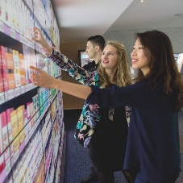

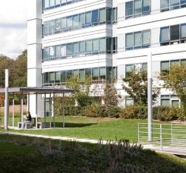

Dassault Systèmes
A purpose-driven company
Combining Art, Science & Technology
for a more sustainable world
20,000 passionate people
From 133 countries
188 sites
One global R&D / 69 labs
Long-term driven
Majority shareholder control
Revenue: €4,5 billions*
Operating margin: 30,2%*
*Figures as of FY 2020 / Non-IFRS
12,260 partners
Software, Technology & Architecture
Content & Online services
Sales
Consulting & System Integrators (C&SI)
Education
Research
290,000 customers
11 industries in 140 countries
26 million users
Game-changing
3DEXPERIENCE platform
Notes:
We are the 3DEXPERIENCE Company. This presentation demonstrates what this means to us.
We are a purpose-driven company. We think of progress and innovation in terms of balance and impact.
As we create value, what are we taking from our planet? Harmonizing product, nature and life lies at the heart of everything we do and what we bring to the world.
We have about 20,000 passionate people from 130 countries across the globe who are at the heart of the company; people sharing the same values, the same passion for innovation.
We also have a large R&D team connected across 69 laboratories.
Dassault Systèmes has the largest PLM and 3DEXPERIENCE market share with more than 290,000 customers in 11 industries worldwide.
A fundamental aspect of 3DS is partnering with clients who are leaders in their own industry segment, on the cutting edge of technology and answering tomorrow’s market needs, whether industry references or start-ups (“shakers”).
Our 12,600 selected partners increase our collective knowledge and reach in the areas technology, sales & services, education & research.
The composition of our shareholding has been consistent since our introduction on the stock market. The majority of the company is owned by the Groupe Industriel Marcel Dassault (owned by the Dassault family) and the company’s management. This stability enables a consistent long-term strategy & long-term investment enabling to be one step ahead of the competition.

Slide 12
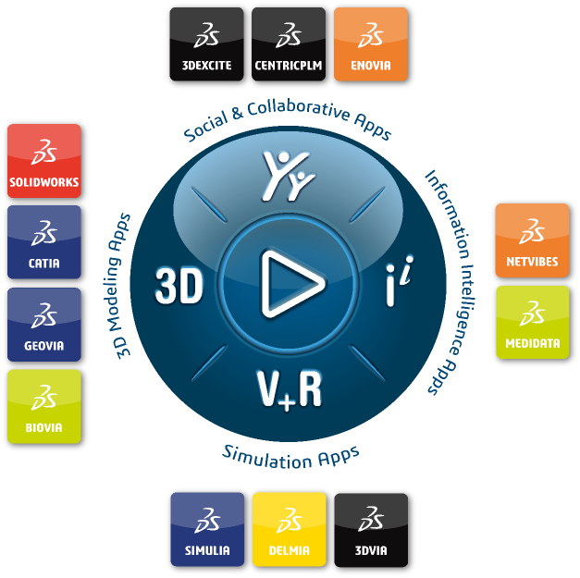











3DEXPERIENCE® powers our brand applications… …for 11 industries
Consumer Packaged
Goods - Retail
Transportation
& Mobility
Home &
Lifestyle
Aerospace
& Defense
Business
Services
Marine &
Offshore
Energy &
Materials
Life
Sciences
Construction,
Cities & Territories
Industrial
Equipment
High-Tech
Notes:
3DEXPERIENCE powers our 12 brands, according to what they stand for:
Social & Collaborative Apps
3D Modeling Apps
Simulation Apps
Information Intelligence Apps
And we serve 11 different industries with tailored Industry Solutions to address their specific challenges.

Slide 13

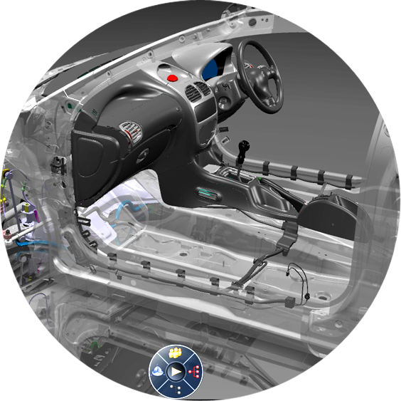




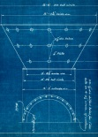

Generational changes with 3DEXPERIENCE
from…
to…
data-driven
online global single instance innovation platform
file-based
model-based
combining multi-physics,
behavior modeling, big data,
social collaboration,
intuitive decision support
static
designs
Notes:
What does this mean for product development? The demands on engineers have increased; to realize the product design, they need to analyze large amounts of data to gain insights into customer needs, translate them into innovative designs and collaborate with manufacturing and suppliers. Thus the need for a data-driven platform. In addition to developing the products, engineers need to model the entire system and its interactions, and simulate them under diverse usage conditions. The system’s behavior is meticulously tuned to provide a flawless experience. A model-based approach is the proven way for this validation.

Slide 14
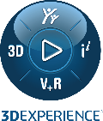
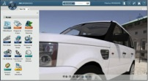
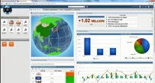
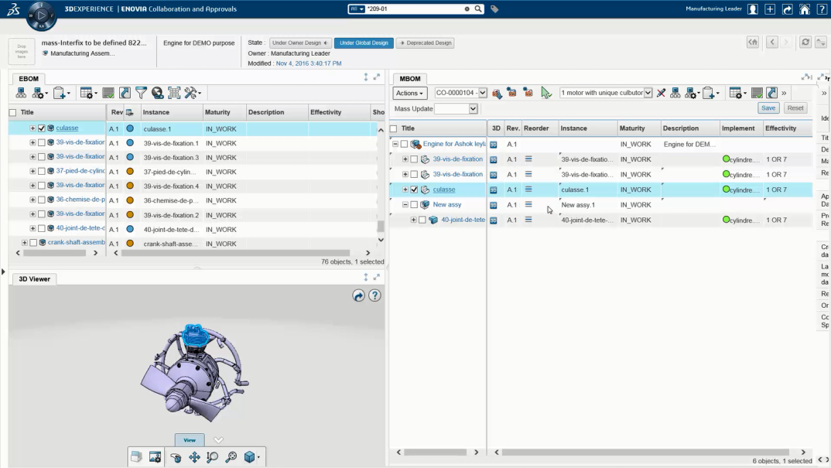


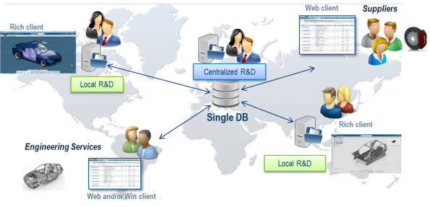
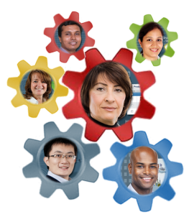



3DEXPERIENCE Platform
Unified user experience
Business Dash-boarding
Full Web Client
On-cloud
Social collaboration
Designed for Cloud
Scalable Global Architecture

Slide 15
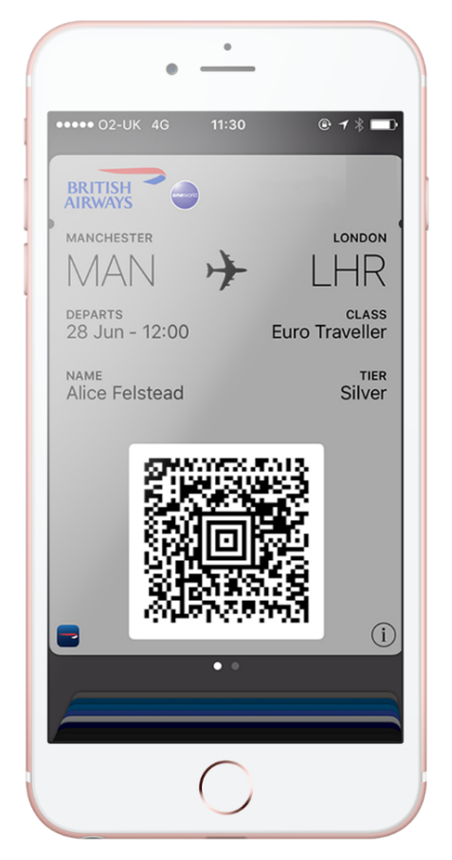
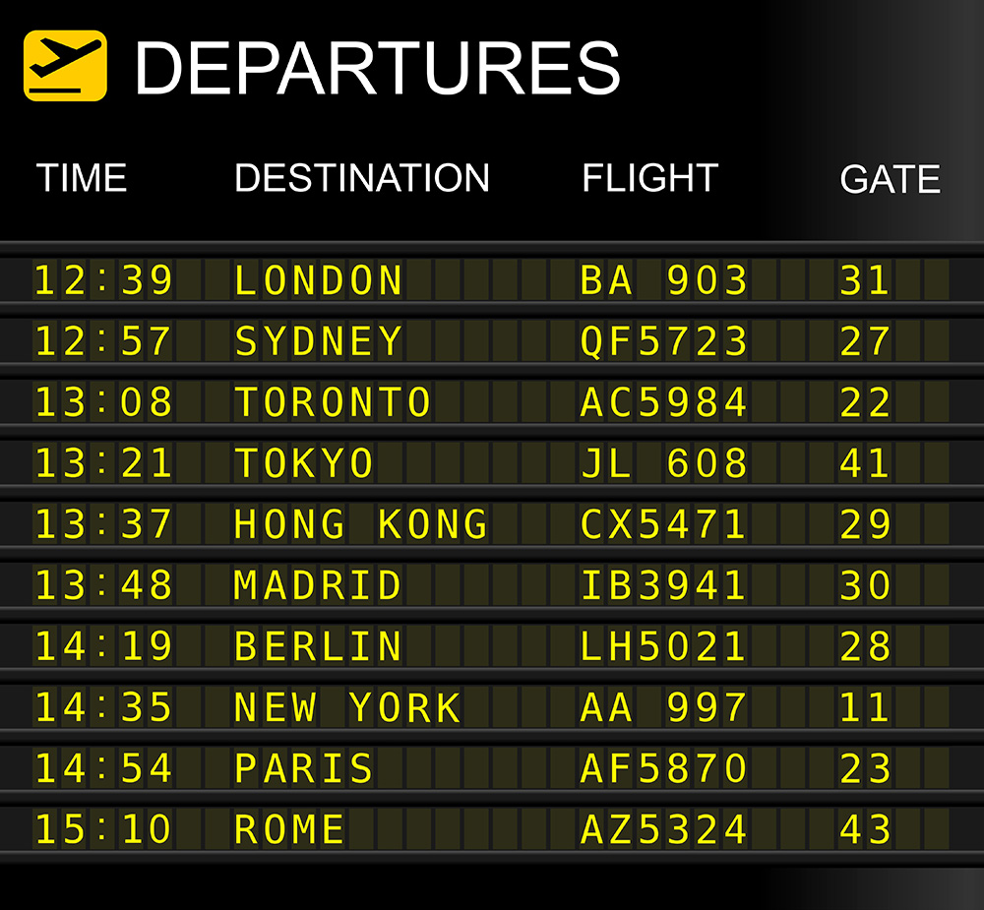

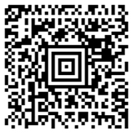
Electronic vs Digital
GATE
31
MANCHESTER
LONDON
GATE
31
09
MAN
LHR
DEPARTS
CLASS
28 Jun – 12:00
Euro Traveller
Auto update
NAME
TIER
Alice Felstead
Silver
Electronic boarding pass
Update
Digital boarding pass
Notes:
We have become pretty good in capturing electronic files. They are not dynamic with regards to changes. Electronic is therefor not the same as digital. Let me explain the difference.
Information is more dynamic in our minds. Let’s take a simple example of a electronic boarding pass. It is a document that is send to you fully automated. Great, right? It is however a disconnected copy, not connected tot the live data…it is a document, automated but just a fixed representation of the data
Data is still subject to change…a.k.a. the late design change. In that case there is no update. The electronic data will not update.
A digital boarding pass is connected with the live data. It will be updated continuously, hence the digital continuity.

Slide 16
Electronic Communications
Mechanical Designer
Finance
Supplier
Shop Floor Manager
Engineer
Quality Engineer
Buyer
SW Engineer
Electrical Designer
Service
Module Planner
Notes:
This is the same for our daily work. Let’s take the example of a product managers requiring some info on a part, cost, supplier performance, etc.
Typically, he will ask some people in the organization, the ones that should have the knowledge. A call and information is presented in an email…. Right there we are already talking about electronic information, no longer connected to the source data. We all have examples of this. Everybody is dependent on information to do their jobs. In reality, there is a larger organization behind the managers that you talk to, just think of the amount of disconnected information.
We believe that this could be done in a much better way…

Slide 17
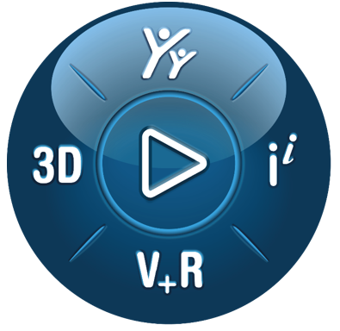
Digital Communications
Mechanical Designer
Finance
Supplier
Finance
Supplier
Shop Floor Manager
Engineer
Shop Floor Manager
Engineer
Quality Engineer
Buyer
Quality Engineer
Buyer
SW Engineer
Electrical Designer
SW Engineer
Electrical Designer
Service
Module Planner
Service
Module Planner
Notes:
What if… (you will here this phrase a lot around here) we communicate on a platform. Platforms are around us all the time nowadays, facebook, linkedin, Airbnb, etc. They connect people or organisations.
Same here, instead of contacting everybody we connect through the platform. Capturing both question and response. Every role can be a data consumer as well as a data creator. This way you are no longer the data hub yourself but is the platform the connecting piece which stays in contact to the live data.
The question is still the same but everybody can be involved or the data is presented directly through intelligent searches. This is a general foundation of a platform – but it enables the digital continuity.

Slide 18
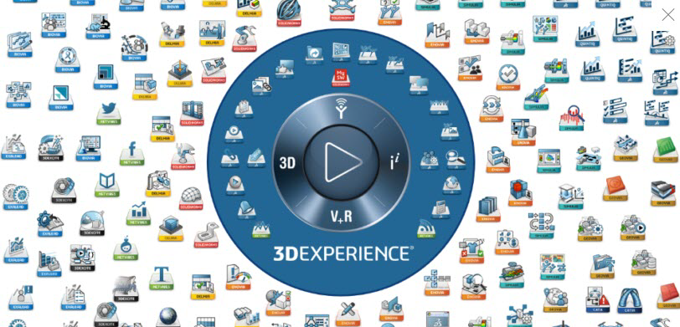

Slide 19

CLOUD
  No IT overhead, no large investment in servers/hardware
  Out of the box data management on the cloud
  Being able to access your data anytime/any where on any device
  Short Implementation / Training/ Ramp up
  Automatic updates, no migrations
  Security

Slide 20
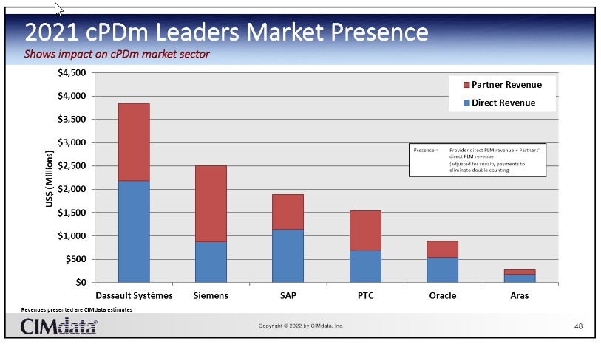

Slide 21
Vandaag
Typische noden bij onze klanten
Agenda
Het 3DEXPERIENCE Platform
Le service client 4.0
Customer Service challenges
Enkele van onze klanten
Onze PLM aanpak
Lessons learned
Waarom Visiativ

Slide 22



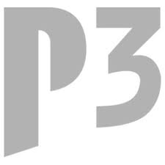














Some 3DEXPERIENCE customers from Visiativ in France
Some 3DEXPERIENCE customers from Visiativ in France

Slide 23












3DEXPERIENCE klanten extended Visiativ PLM team in Benelux
Andere PLM klanten in Benelux
SOLIDWORKS PDM Professional klanten in Benelux

Slide 24
3DEXPERIENCE at
Remark: standard CAD at CAPSUGEL is Inventor
On premise R2017x migrated to 2020X in Q2 2022x
CAPSUGEL has
20 basic licenses with Inventor integration
1 x with Autocad integration
Extra 80 casual users (< 40 Hrs usage/month) for consulting
On premise
Named users

Slide 25
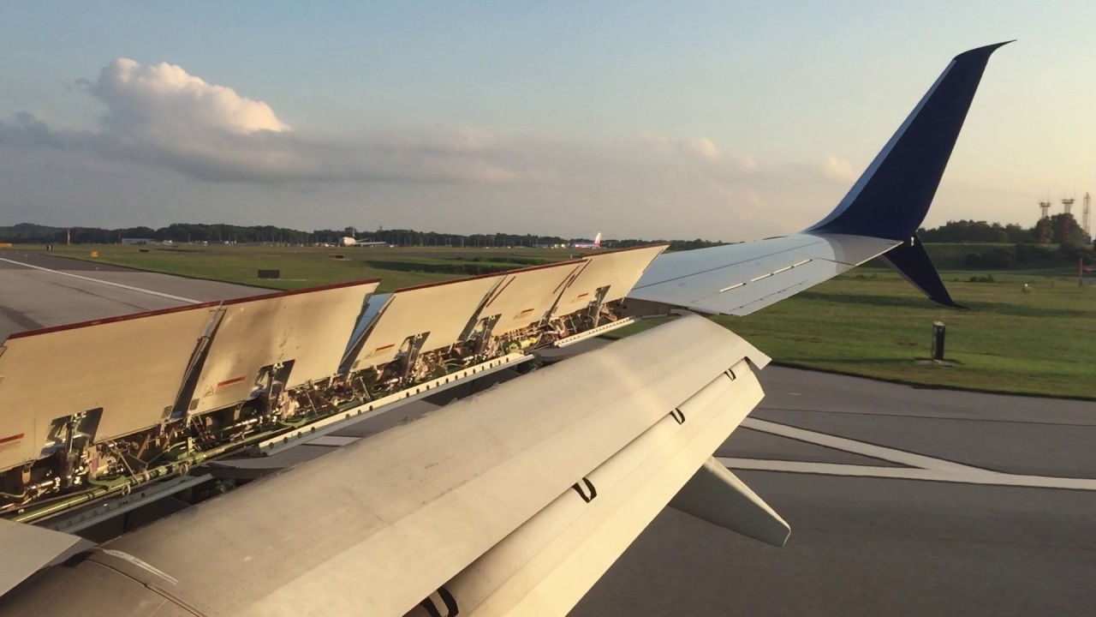
ASCO
Wing mechanisms

Slide 26

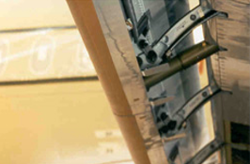
In production:
300 + basic 3DX ENOVIA licenses
50 + CATIA V5
100 + casual users for supplier communication
100 + other specialised licenses like BOM management
On premise, also specific development

Slide 27
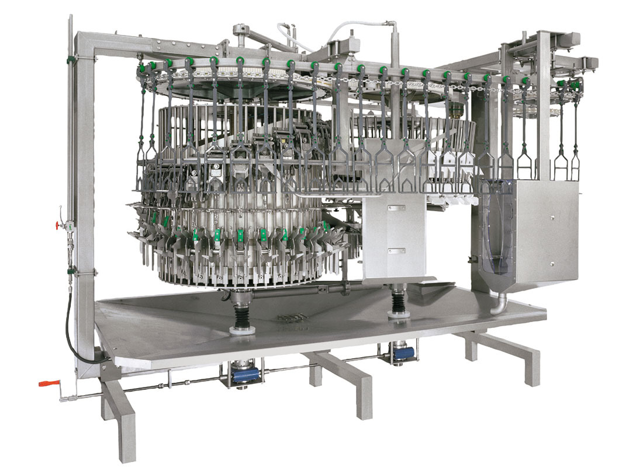
Plant Lay Out Project = 3DX OOTB in the cloud
75 + Named users Cloud
100 + Named users on premise
X-BOM manufactering
50 + Catia V5
Also project management, factory simulation,
Configuration management,…

Slide 28
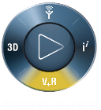
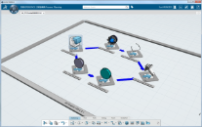
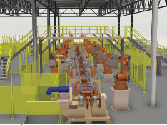
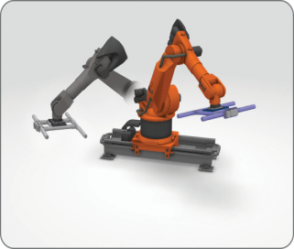
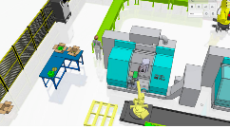
3DEXPERIENCE DIGITAL TWIN
+
+
+
Plan Operations
Plant Layout
Machine Simulatie
Factory Flow Simulatie
Efficiency
Performance
Innovation

Slide 29
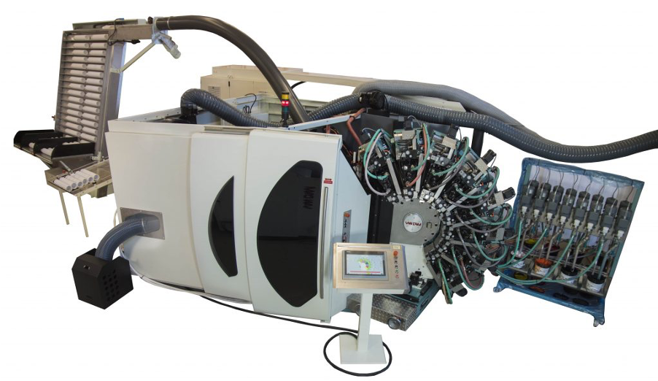
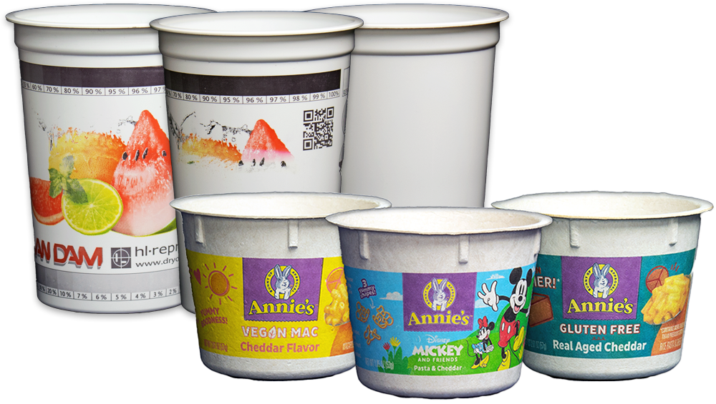
Al 60 jaar is Van Dam Machine een pionier en innovatief bedrijf dat apparatuur
levert voor het decoreren van harde verpakkingen, gespecialiseerd in het
ontwerpen, ontwikkelen en produceren van droge offsetdrukmachines en
fotografische FDoR drukmachines
Migratie van CATIA V5 en Smarteam naar 3DX CATIA en 3DX Enovia.
9 named users met classification management, E-BOM
Fase 2 M-BOM en ERP integratie.
Verdere exploratie 3DX mogelijkheden buiten engineering.
Notes:
FDOR = Flexo direct on RIGID combines low decoration costs with sustainable direct printing, patented

Slide 30
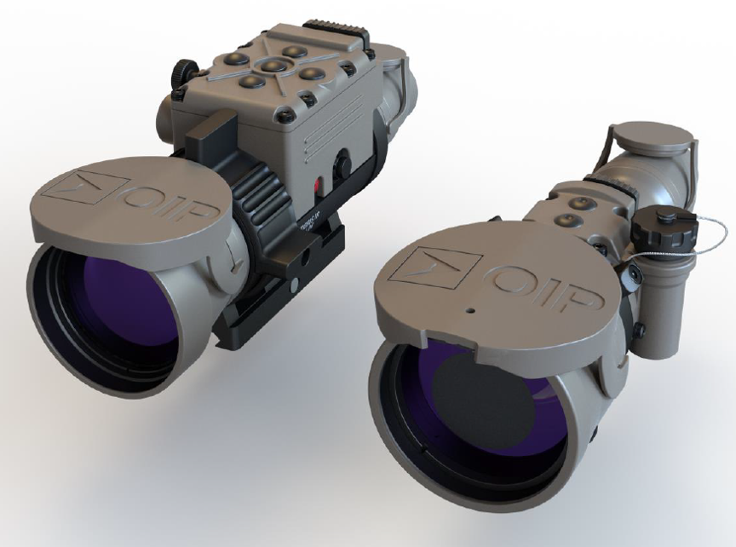
OIP sensor systems was established in 1919 as “optique et Instruments de
Précision” in Ghent. Application area comprise day/night observation, targetting
sighting & situational awareness for defence,law enforcement & security.
OIP has also a successfull space division.
120 employees and bought 100 basic roles of which:
  Solidworks integration and Altium integration
  Classification manager, Change manager, E-BOM/ M-BOM,
  Quality management, Project management

Slide 31
Suzlon Blade Technology, Hengelo 35 employees
2 x Heavy Catia modules
8 basic 3DX normal user
13 3DX user with limited usage
RequirementsEngineer,Project planner, manufacturing engineer, …
4x Learning modules
1 x draftsight and 2 x Solidworks
ALL ON CLOUD
Process defined first, support top management, step by step approach
ISO 9001 Certification and Project management high wins
Hengelo drives and is example for Germany and India

Slide 32
Vandaag
Typische noden bij onze klanten
Agenda
Het 3DEXPERIENCE Platform
Le service client 4.0
Customer Service challenges
Enkele van onze klanten
Onze PLM aanpak
Lessons learned
Waarom Visiativ

Slide 33
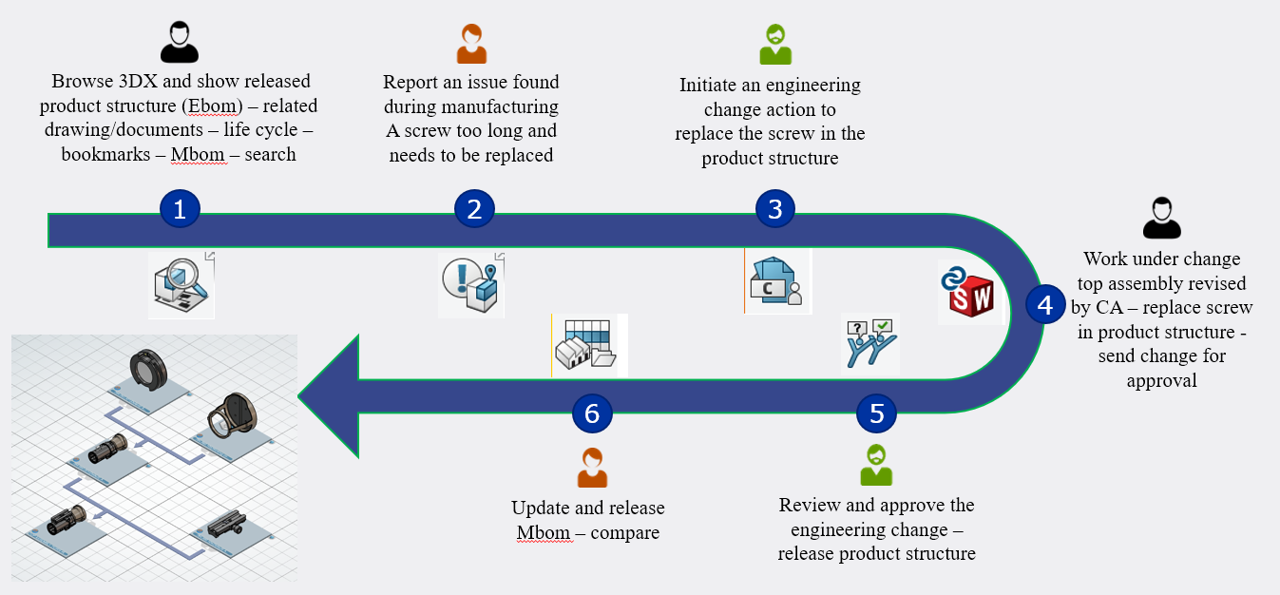
Scenario voor demo

Slide 34
Our approach is based on a typical IT enterprise solutions deployment methodology…
Project Management
Change Management
1. Define
a vision
2. Analyze
the processes
3. Design
the solution
4. Build
the solution
5. Deploy
the solution
A
B
C
D
E
Value assessment report
Scope of work
ROI calculation
Critical Success Factors
Project Proposal
Synthetic view main processes
Detailed Process Models
Data Inventories
Product Structure
Configuration & Maturity
Management practices
Migration & Integration requirements
Data Model
User profiles
Configuration & Maturity Management
Reports
Workflows
Architecture & Platform Definition
List of needed Developments
Customized Solution
Required Developments
Methodology Guide
Training Manuals
Test reports
Deployed Solution
Migrated Data
Integrated Solution
User Satisfaction Reviews

Slide 35
Fase 1a

Slide 36
Fase 1b

Slide 37
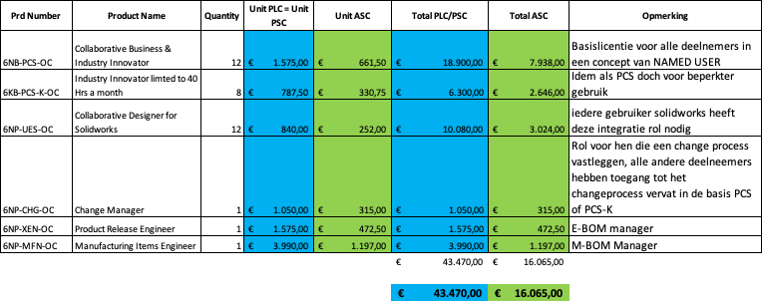
Fase 2

Slide 38
Fase 3

Slide 39
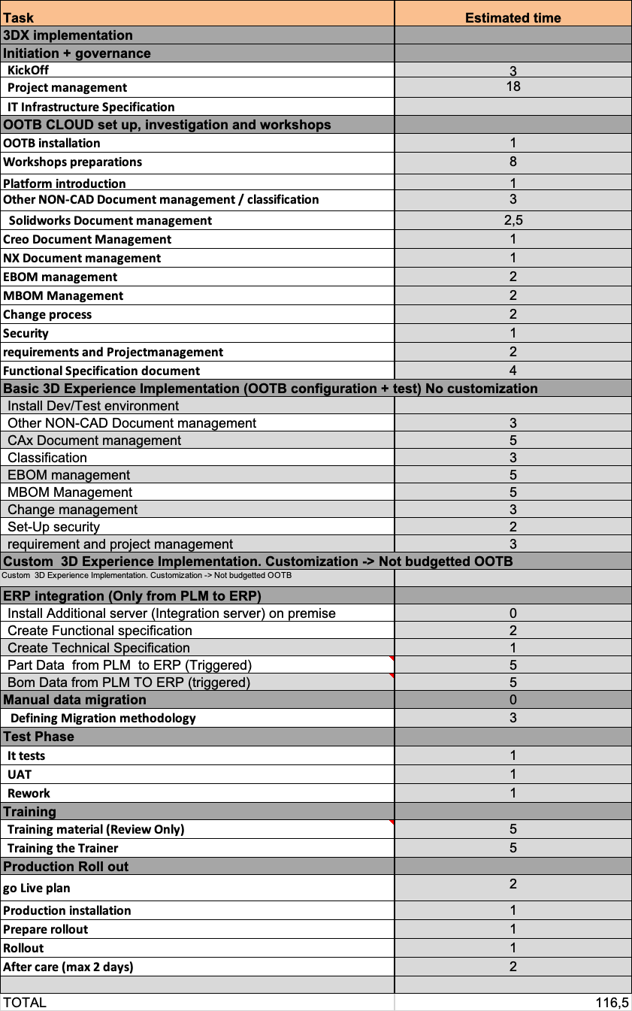

Slide 40
Vandaag
Typische noden bij onze klanten
Agenda
Het 3DEXPERIENCE Platform
Le service client 4.0
Customer Service challenges
Enkele van onze klanten
Onze PLM aanpak
Lessons learned
Waarom Visiativ

Slide 41
Potential PLM Business Opportunities
Cycle Time : 35% to 80% Faster
Productivity : 20% to 30% Increase
Material Cost : 10% to 25% Reduction
Innovation Yield : 15% to 20% Fewer ECR
Overhead Costs : 4% to 12% Reduction
Source - AMR Research 2003
Notes:
Message - In a decreasing market there always are opportunities.
What we hope to show you through this presentation is how you can leverage these opportunities through Best in Class PLM
The opportunities shown here are both ends of the scale. The opportunities will clearly differ from large OEM company to a 4th tier supplier, each has a different objectives. Products are also different from a short ‘refresh’ project to a full 5 year program with a new floor pan and powertrain. Also the objective for each program could be different, an example is a new entry product which could have a low ROI as it is a company strategy decision to a new program with an established client base.
So you can see it benefits will vary greatly between OEM’s and suppliers.
What we hope to do through this presentation is to show you how you can gain some of these benefits for your company.

Slide 42
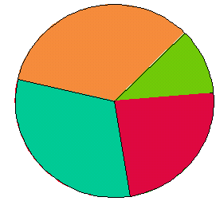
PLM and Innovation : How much time has the engineer ?
34% Administration
Reporting
Planning
Control
INNOVATION PART
Only 11%
Creative Engineering Activities
31% Communication / Contacts
Meetings
mail and E-Mail
Telephone conversation
24% Waiting for
Decisions
Information
Confirmation
Source: R.L. Harmon (96); Holmes and Yazdani (99)
Notes:
Given this challenge that we need to significantly reduce the Time To Market, let us look at the way Engineer is spending time. “24% Waiting for” and “31% Communication/Contacts”. If we could cut these down to a 3rd of this, the amount of time he would spend on “Creative Engineering” would go up by FOUR TIMES, increasing the product competitiveness, reducing development time, and adding to the bottom line and top line

Slide 43
Key success factors
Strong and continuous sponsorship of top management
Strict project management
  Clear definition of goals, activities, milestones, organization, responsibilities
  Active partner management
Process reengineering parallel to system design and introduction
Proactive information, involvement, and training of users
Stepwise introduction of PLM functionality
From :
PDMAX! e-business environment – Maximizing the value of integrated Product Data Management as a key for e-business
Ruhr-Universität Bochum – McKinsey&Company – may 2001

Slide 44
Reasons to fail in PDM / PLM
Resistance to change
82%
Insufficient Engagement of Management
72%
Objectives not realistic
65%
Weak Project management
54%
Reasons of change are NOT convincing
46%
Insufficient competencies of Project team
44%
« people make the enterprise, not the systems"
Perimeter of project wrong defined
44%
Lack of cross functional vision
41%
Neglect of technological aspects
36%
(Source : Deloitte Consulting)
0%
50%
100%

Slide 45
Vandaag
Typische noden bij onze klanten
Agenda
Het 3DEXPERIENCE Platform
Le service client 4.0
Customer Service challenges
Enkele van onze klanten
Onze PLM aanpak
Lessons learned
Waarom Visiativ

Slide 46
Waarom 3DEXPERIENCE ?
Uitstekende integratie met Solidworks en CATIA vandaag en toekomstgericht.
3DX is het strategische PLM platform voor Dassault Systèmes en zijn klanten. Gewoon de volgende stap na e-PDM.
  Werkelijk 1 platform, alle brands zijn verplicht hierop verder te ontwikkelen:
    Future proof voor verschillende jaren.
    Groot aantal van apps bvb Simulatie, virtuele productie , kwaliteit, sustainable innovation manager, etc.
  State of the art bvb userinterface, widgets, Data driven, Model based, enz…
  Bepaalde vernieuwingen
  Think big, start small and accelerate fast.
Dassault systèmes is duidelijke marktleider in het PLM domein.
  E.g. partners met jaren ervaring in het implementeren van PLM oplossingen.

Slide 47
Waarom Visiativ
Eén van de grootste business partners van Dassault Systèmes:
Sterke kennis Solidworks/Catia/e-PDM/3DX.
  Extended team in Benelux met 30+ specialisten
  Behoorlijk aantal klanten in 3DX PLM.
  Behoorlijke omzet in SW/e-PDM/CATIA/3DX.
  Jaren ervaring in het implementeren van PLM oplossingen samen met klanten.
Is Visiativ reeds uw vertrouwde adviseur ? Laat ons daar verder op bouwen.

Slide 48
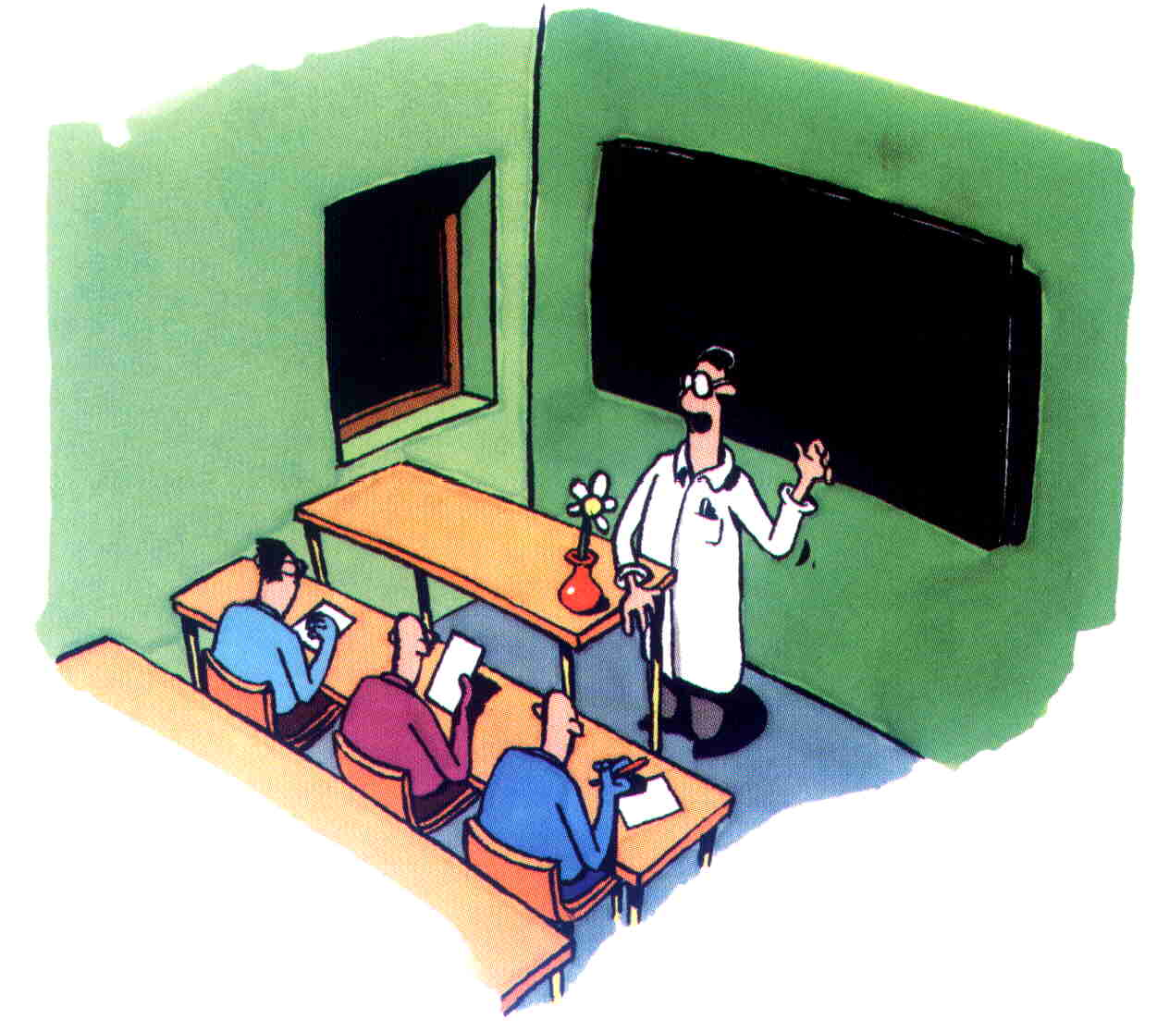
Bedankt voor uw
aandacht

Slide 49
Vragen?
Erik.dewit@visiativ.com
+32 473 88 17 15

Slide 50

SOLIDWORKS Eindejaarspromo 2022
Premium licentie voor de prijs van Standard
Optioneel Aanvullend Voordeel:
+3 jaar onderhoud (updates/helpdesk) ineens
Vraag je accountmanager naar de voorwaarden!
Of mail: info@designsolutions.nl / .be

Slide 51
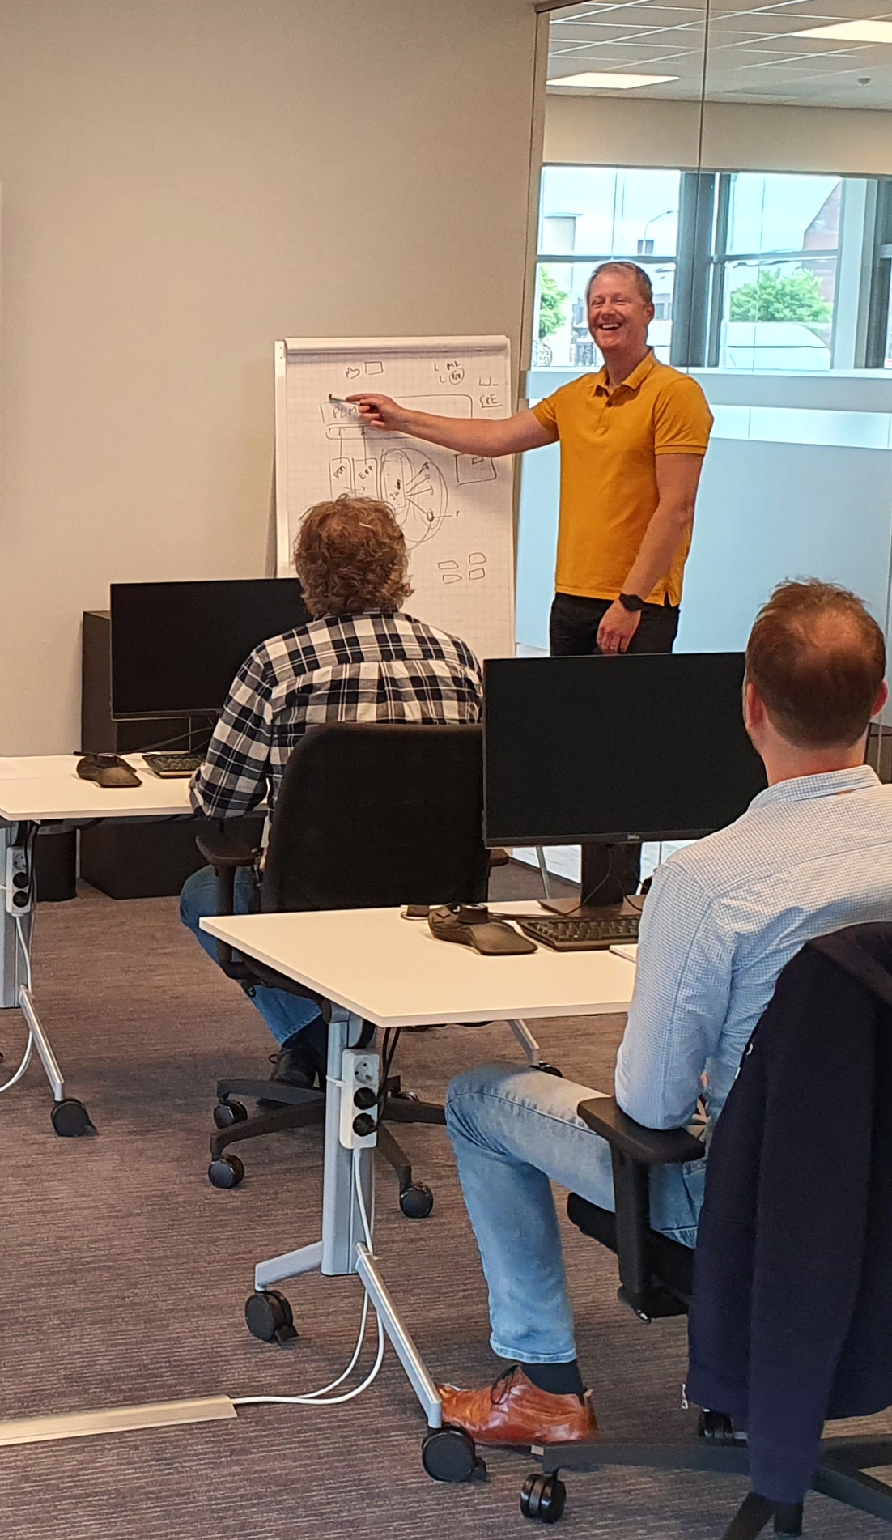
Design Solutions Eindejaarspromo 2022
20% korting op SOLIDWORKS training
Boeken vóór 23 december, mag gevolgd worden in 2024 en te combineren met trainingsvoucher (inbegrepen bij onderhoudscontract).
Vraag je accountmanager naar de voorwaarden!
Of mail: info@designsolutions.nl / .be

Slide 52

Bedankt voor je aandacht
Tijd voor de borrel!

