Slide 1

MANAGING CUSTOMER SERVICES ACTIVITIES
Enhance your Customer Service with Visiativ Platform and get ready for Industry 4.0

Slide 2







Let’s get in touch
Sébastien Vincent
Customer Transformation Program Director
Dilis Biesheuvel
Sales
Director
Jeroen Maas
Business
Consulting

Slide 3















The Manufacturing Process
Create
Design
Produce
Sell
Maintain
Engineering & Manufacturing
Sales
Data & Lifecycle Management
Customer Services
Industrialization
Quality
Collaboration
Notes:
Caler les personna avec les BX
Ajouter 3DPrint

Slide 4
Investing in Customer Service is usually more profitable than initial sales
Margin on sales
  39%
Are you
ready ?
  27%
New equipment
Aftersale
Source : Bain & Company

Slide 5

Agenda
Customer Service challenges
Le service client 4.0
Customer Service challenges
Customer cases
Demo
Features at a glance
Benefits

Slide 6










Key customer service trends
3D
  BtoB relationships
  become omni-channel
  Towards
  « augmented » aftersales
  Towards a SERVICE
  business model
  The growing value
  of customer service
  Instantaneous communications

Slide 7





Digitalize your Customer Service
with Visiativ
The added value Cloud Customer Service Platform responding to equipment manucturers’ issues
Transform your after sales activities
into a profit center
Increase after sales services
efficiency
Easily Share
high quality technical documentation
Improve customers & distributors
satisfaction

Slide 8

Visiativ : Smart Customer Service Platform
for equipment manufacturers
HELPDESK PORTAL
Equipment & general documentation
Support Request
Equipment commissioning
Maintenance contracts & warranty conditions
Faq
News
Spareparts catalogs
Interactive technical documentation
Spareparts search capacities
Request for quotation and/or ordering
Other catalogs entries (consummables, accessories,…)
MAINTENANCE
Field Services activites (Interventions)
Equipment monitoring & alerts (based on ioT)
360 CUSTOMER & EQUIPMENT VIEWS
Centralizing all data related to customers & equipment (support request, interventions, iOT alerts, orders, technical documentation, spare parts…)

Slide 9
5 modules
1. Helpdesk Portal
  2. Ticketing
  Equipment and documentation
1. BOM & Spareparts + request for quotation (no price information) 1
1. BtoB Commerce (sales of parts, sales any other kind or articles)
Field Services
iOt & alerts

Slide 10
Agenda
Le service client 4.0
Customer Service challenges
Customer cases
Demo
Features at a glance
Benefits

Slide 11
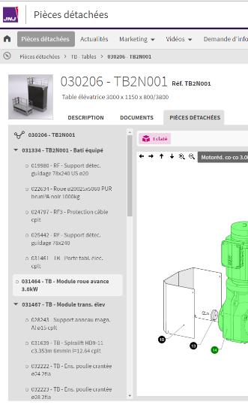








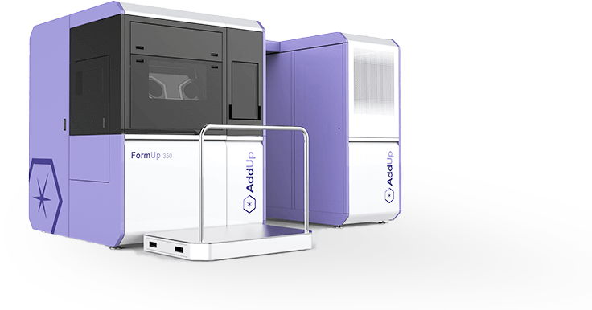









Industrial equipment
  Rollomatic
  High precision cutting tool grinding machines
  Unista
  Robotic cells
  Altix
  Equipment for
  the manufacture
  of printed circuits
  Willemin Macodel
  Machine tools
  Fives Celes
  Induction heating and cooling machines
  Sermas
  Surface milling
  and carbon sawing machines
  Armand-Moulet
  Compactors
  Holweg
  Paper bag machines
  JNJ
  Robots for care and handling of cheeses
  Saint Dizier Environnement
  Water treatment equipment
  Addup
  Metal additive manufacturing
  machines
  Farbal
  Sleeve wrapping machines
  Pack’R
  Liquid filling
  machines
  Quadra
  Equipment for the manufacture of precast concrete products
  Hasler Group
  Industrial dosing-weighing equipment
  Fives Cryomec
  Cryogenic pumps

Slide 12
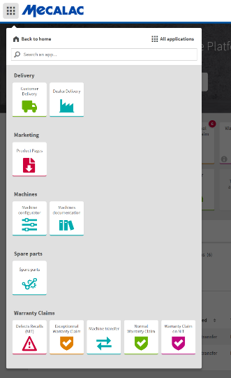

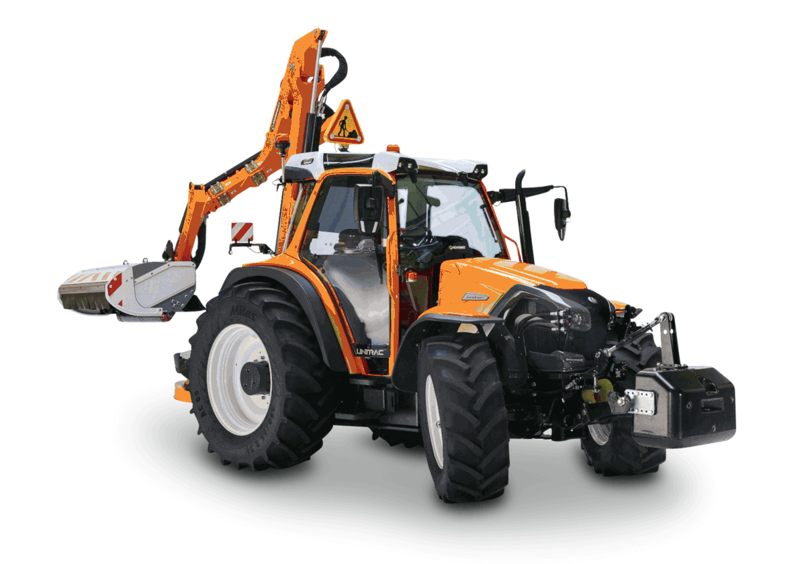












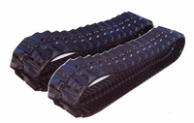




Equipment for agriculture, road construction
or transportation
  Mecalac
  Heavy equipment
  for road construction
  Noremat
  Agricultural equipment for road shoulders
  Caruelle-Nicolas
  Agricultural spraying equipment
  Tecnoma
  Agricultural spraying equipment
  Berthoud
  Agricultural spraying equipment
  Dubrulle Downs
  Farming equipment
  for harvesting and
  post-harvesting
  beets and potatoes
  Richel
  Farming equipment
  for greenhouses
  Maf Roda
  Equipment for
  fruit and vegetables
  grading and packaging
  Peltrax
  Wear parts
  and equipment
  for heavy construction
  Blue Bus
  Electric Buses
  Marrel
  Equipment for
  industrial vehicles
  Baroclean
  Maintenance equipment for sanitation networks
  Dangel
  Vehicle
  4x4 conversion

Slide 13

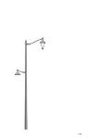













Professional equipment
  Ceva
  Pullet vaccination equipment
  DMS Imaging
  Medical imaging equipment
  Schiller Medical
  Vital function diagnostics equipment
  Ragni
  Public and urban lighting
  Maviflex
  Flexible high-speed doors
  Safir - Accedia
  Automatic
  collective doors
  Airwell Residential
  Heating and air conditioning
  Charvet
  Professional kitchen equipment
  La Cornue
  Professional kitchen equipment
  Fermob
  Outdoor furniture
  Lafuma Mobilier
  Outdoor furniture
  Getrac
  Products and tools
  for garages and industral shopfloors
  Sewosy
  Equipment for
  building security

Slide 14
Agenda
Le service client 4.0
Customer Service challenges
Customer cases
Demo
Features at a glance
Benefits

Slide 15
From the commissioning of the equipement to troubleshooting management

Slide 16
Agenda
Le service client 4.0
Customer Service challenges
5 customer cases
Demo
Features at a glance
Benefits

Slide 17
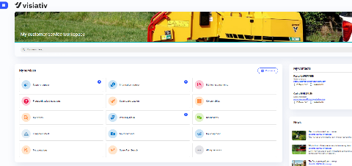
The Helpdesk Customer Portal
Available 24/7 in multiple languages
Support Request follow up & tracking
Product documentation
Commissioning of new equipment
Maintenance contract & warranty conditions (SLAs)
News
Faq
Other documentation

Slide 18
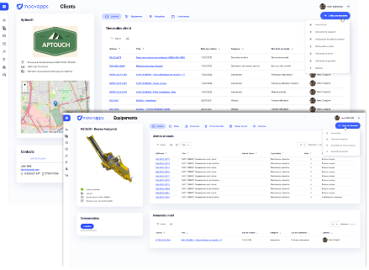
The 360 Customer & Equipment
views
A complete vision on customers & equipment activities
Follow up of activities (support request, commisionning, iOT Alerts, warranty request, interventions, …)
Documentation
Spare Parts
Orders
iOT Dashboard

Slide 19
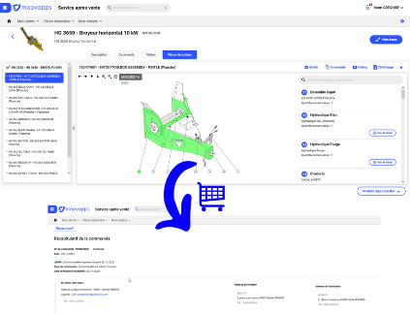
The spareparts catalog
Easy access to spareparts catalogs & ordering
Intuitive navigation through Bill of Material
Online request for quotation
Exploded views import
Access to product catalogs
Ordering spare parts & products
Orders & delivery follow up

Slide 20
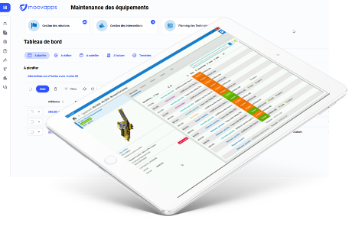
Field Service activities (interventions)
Managing Interventions
Scheduling interventions & missions
Easy access to actions to be treated
Offline access to customers and equipment informations
Work Order Report
Intervention control
Extraction of data for invoicing

Slide 21
Agenda
Le service client 4.0
Customer Service challenges
Customer cases
Demo
Features at a glance
Benefits

Slide 22





Benefits
  MODULAR
    Think big
    Start small
    Accelerate fast
  CLOUD SUBSCRIPTION MODEL
    Fast and easy start of the solution
    Low initial investment
    Low risk
    Almost no basic infrastructure needed
    Updates of software are easy and included
    High security
4.0
  A lot of Customers already
      to be trusted software solution and company
      130 + developpers
      References to learn from
Notes:
MOOVAPPS HAS A LOT OF ADVANTAGES SUCH AS:
Stable, robust solution with already a lot of customers
Very modular, so think big, start small and accelerate fast is possible.
Only investment is initiall set up as a service cost, no further heavy investment as you pay a fee per month.
CLOUD means extremely well protected and no “migration cost to higher versions”, included in price

Slide 23
Thank you
www.visiativ.com

